Slide 1
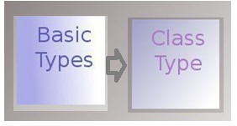
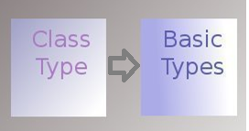
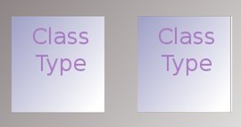
Type conversions (User Defined type conversions)
Three types.
1.Basic type to Class type (Basic –class)
In this type of conversion source type is basic type and destination type is class type
When we create objects using the variables of primary data types then it is called as basic to class type conversion.
2. Class type to Basic type (Class-Basic)
When we assign an object to a primitive data type’s variable, then it is called as class type to basic conversion
3. Class type to Class type (Class- class)
When we assign an object of a class into the object of another class then it is called as class to class conversion.
int eid;
Employee e= eid;
MyNumber num_obj;
int n=num_obj
Triangle t(10,20);
Rectangle r=t;
//Triangle to Rectangle

Slide 2
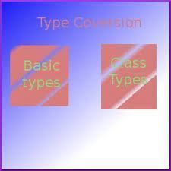
1. Basic type to Class type Conversion
Create objects using the variables of primary data types.
Uses the constructor to perform conversion during the object creation.
Ex. A user-defined class named MyInteger, which represents an integer value.
Has a private integer member called value, and a constructor that takes an integer as an argument to initialize the value.
//Basic type to Class type
class MyInteger {
private:
int value;
public:
MyInteger(int val)
{
value=val;
}
int getValue() {
return value;
}
};
int main() {
int num = 42;
MyInteger myInt = num; //Basic Type (int) to Class Type(MyInteger)
cout << "The object value is " << myInt.getValue();
return 0;
}
int num;
MyInteger myInt= num;

Slide 3
MEETING DURATION TRACKER
→Imagine you are developing a software tool for a Project Management Team.
→This tool tracks and displays the duration of various project meetings in hours and minutes. You've created a Time class that allows you to easily represent and manipulate meeting durations.
→ How can you Implement the Time class to simplify the process of tracking and displaying meeting durations for the project management team. Provide an example scenario where the Time class would be beneficial in helping the team keep track of their meetings' durations.
Input:
Duration 95 minutes.
Output:
The program uses the Time class to convert the meeting duration from minutes to hours and minutes and then displays the result.
Time = 1 hrs and 35 mins
Logic:
1 Define a Time Class with two private member variables: hours and
minutes.
2.Define a constructor for the Time class that takes an integer argument t,
which represents the duration in minutes.
3. Implement a Display method within the Time class to display the duration
in hours and minutes in a human-readable format.
4. In main() Create an instance of the Time class named T1.
Define an integer variable dur to represent the duration in minutes
5.Display Result:

Slide 4
//Meeting Duration Tracker
#include<iostream>
using namespace std;
class Time
{
int hours;
int minutes;
public:
Time(int t) // constructor
{
hours = t / 60; //t is inputted in minutes
minutes = t % 60;
}
void display()
{
cout << "Time = "<<hours<< " hrs and " << minutes << " mins\n";
}
};
int main()
{
int dur = 95;
Time t1=dur; //Conversion of int type to Time class object
t1.display();
return 0;
}

Slide 5
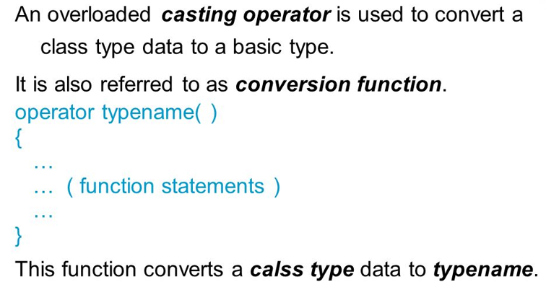
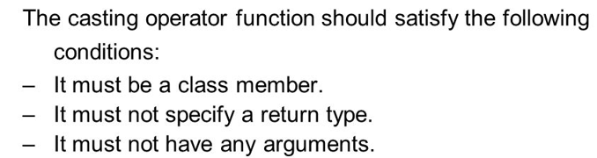
2. Class type to Basic Type
#include <iostream>
using namespace std;
class Number {
int n;
public:
Number(int n){
this->n = n;
}
void disp() {
cout << n;
}
operator int() {
return n;
}
};
int main()
{
Number numb(10);
numb.disp();
int x = numb; // Calls numb.operator int()
cout << "\nThe value is: " << x;
return 0; }
Assigning an object to a primitive data type’s variable is called class type to basic type

Slide 6
Community Resident Information Management System
→ Imagine you are a software developer working for a resident living community.
Your task is to create a Resident class to manage the personal information of residents, which includes their names and ages.
You also need to implement a custom conversion operator in the Resident class to transform the resident's details into a formatted string for record-keeping and documentation purposes.
Input:
Resident 1: Name - "Amit Kumar", Age - 30
Resident 2: Name - "Sneha Sharma", Age - 45
Resident 3: Name - "Rajesh Patel", Age - 60
Output:
When requesting details for Resident 2:
"Sneha Sharma (45 years old)“
LOGIC
Define a Resident class with name and age attributes.
Create a custom conversion operator in the Resident class.
Gather name and age information.
Create Resident objects using the gathered data.
Utilize the conversion operator to display resident information

Slide 7
//Community Resident Information Management System
#include <iostream>
#include <string>
using namespace std;
class Resident
{
string name;
int age;
public:
Resident(const string& n, int a)
{
name = n;
age = a;
}
operator string()
{
return name + " (" + to_string(age) + " years old)";
}
};
int main()
{
// Create Resident objects
Resident r1("Amit Kumar",70),
r2("Sneha Sharma",82),
r3("Rajesh Patel",75);
string s1,s2,s3;
s1=r1; //class to basic type conversion
s2=r2;
s3=r3;
// Output resident information
cout<<"Resident Details in Format\n";
cout<<s1<<endl;
cout<<s2<<endl;
cout<<s2<<endl;
return 0;
}

Slide 8
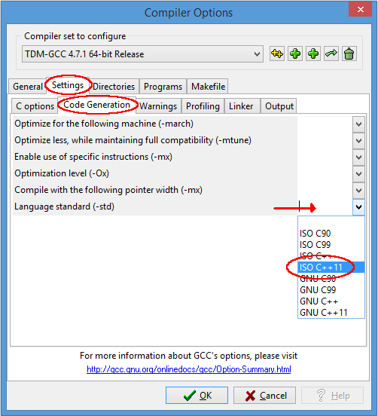
If to_string() is not working in devC++ , make these settings

Slide 9
3. Class to Class type conversion
An obj of one class is created with obj of another class
Obj2 = Obj1;
Obj1 is an instance of class One and Obj2 is an instance of class Two
The class One type data is converted to class Two type data
One is known as the source
Two is known as the destination class
Class to class conversion is also possible using casting operator in source class.
Operator type will be that of destination class.
class One { // Source class
int value;
public:
One(int m) { value=m; }
int getValue() { return value; }
operator Two(){ // Custom casting operator for class conversion to Two
{ return Tow(Value);
}
};
class Two { // Destination class
float value2;
public:
Two(float f) { value2=f; }
int getValue() {
return value2;
}
};
int main() {
One c1(10);
Tow c2 = c1; //class to class conversion
cout << “Value in c2: " << c2.getValue();
return 0;
}
operator destination_class()
{
return destination_class_obj;
}

Slide 10
//METERS TO FEET DIST
#include <iostream>
using namespace std;
class Feet; // Forward declaration of the destination class
class Meters { // Source class representing distance in meters
float value;
public:
Meters(float m) { value=m; }
float getValue() {
return value;
}
operator Feet(); // Custom casting operator for class conversion to Feet
};
class Feet { // Destination class representing distance in feet
float value;
public:
Feet(float f) { value=f; }
float getValue() {
return value;
}
};
// Class conversion from Meters to Feet
Meters::operator Feet() {
return Feet(value * 3.28);
}
int main() {
// Creating an object of class Meters
Meters mts(10.0);
// Class type conversion to Feet
Feet fts = mts;
cout << "Distance in Feet: " << fts.getValue() << " feets“;
return 0;
}

Slide 11
Currency Exchange Tool
Yor are developing a currency exchange application, in which the 'Currency' and 'ExchangeRate' classes are key components.
--> When a user enters US Dollars for conversion into Indian Rupees (INR), this operator ensures a smooth process, providing the equivalent amount in INR.
→To allow users to input amounts in INR and convert them into US Dollars while maintaining the existing classes and conversion operator, a similar approach using the 'Currency' class's custom conversion operator can be applied.
Input:
Amount in US Dollars (USD): 100
Exchange Rate (USD to INR): 75.0
Output:
Equivalent Amount in Indian Rupees (INR): 7500.0
LOGIC
Create a class USDollar with data member amount .
Implement a conversion operator in the USDollar class that can convert USD to INR using the provided exchange rate.
Prompt the user to enter the amount in US Dollars and the exchange rate.
Create an object of the USDollar
Use the custom conversion operator to convert the USD amount to INR based on the exchange rate.
Display the converted amount in INR

Slide 12
//Currency Exchange Tool
#include <iostream>
class USDollar
{
float amount;
public:
USDollar(float usd) { amount=usd; }
//Custom conversion operator to convert USD to INR
operator double() {
return amount * exchangeRate;
}
// Static exchange rate (1 USD to INR)
static float exchangeRate;
};
double USDollar::exchangeRate = 75.0;
int main()
{
float usdAmount; float inrAmount;
// Input: Amount in US Dollars and Exchange Rate
cout << "Enter the amount in US Dollars (USD): ";
cin >> usdAmount;
// Calculate the equivalent amount in Indian Rupees (INR)
USDollar usd(usdAmount);
inrAmount = usd;
// Conversion operator is automatically called here
// Output: Display the equivalent INR
cout << "Equivalent Amount INR:" << inrAmount << endl;
return 0;
}

